Slide 1

SPARK

Slide 2
CONTENTS
Creating DataSets
Working with RDDs
Using DataFrame Aggregate Functions

Slide 3
Why do we need Spark DataSet?
To have a clear understanding of Dataset, we must begin with a bit of history of spark and evolution.
RDD is the core of Spark. Inspired by SQL and to make things easier, Dataframe was created on top of RDD.
Dataframe is equivalent to a table in a relational database or a DataFrame in Python.

Slide 4
RDD provides compile-time type safety, but there is the absence of automatic optimization in RDD.
Dataframe provides automatic optimization, but it lacks compile-time type safety.
Dataset is added as an extension of the Dataframe. Dataset combines both RDD features (i.e. compile-time type safety ) and Dataframe (i.e. Spark SQL automatic optimization ).

Slide 5
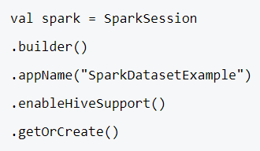
How To Create a Spark DataSet?
There are multiple ways of creating a Dataset based on the use cases.
1. First Create SparkSession
SparkSession is a single entry point to a spark application that allows interacting with underlying Spark functionality and programming Spark with DataFrame and Dataset APIs.

Slide 6
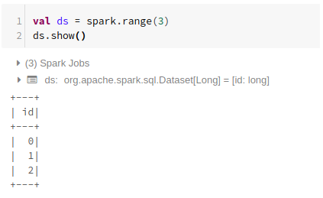
To create a dataset using basic data structure like Range, Sequence, List, etc.:
Using Range

Slide 7
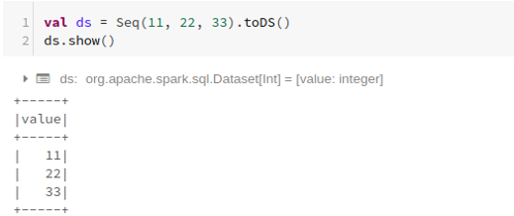
Using Sequence

Slide 8
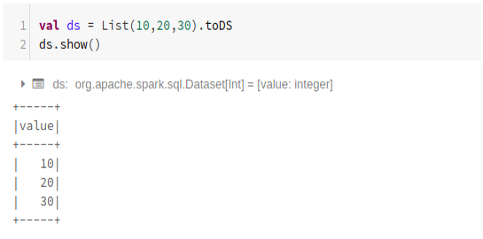
Using List

Slide 9
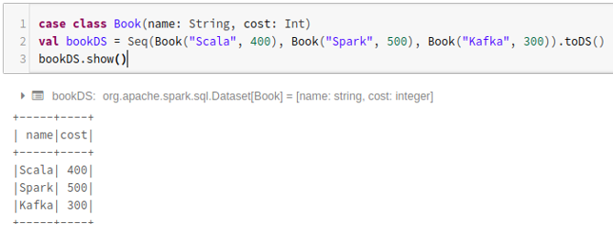
To create a dataset using the sequence of case classes by calling the .toDS() method:

Slide 10
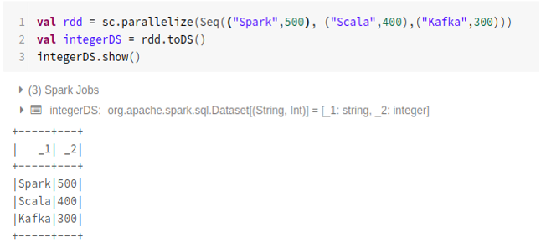
To create dataset from RDD using .toDS():

Slide 11
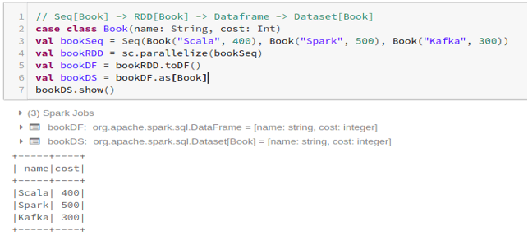
To create the dataset from Dataframe using Case Class:

Slide 12
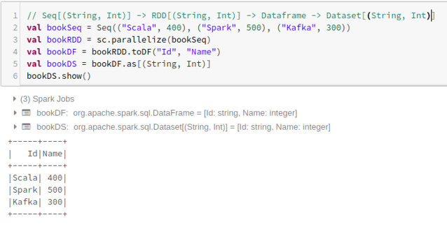
To create the dataset from Dataframe using Tuples :

Slide 13
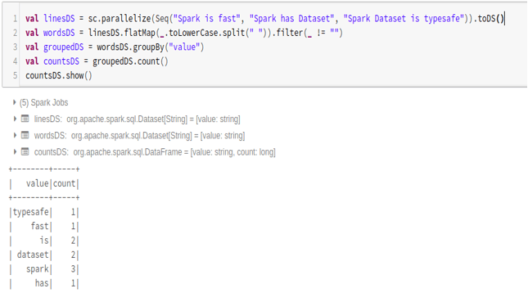
2. Operations on Spark Dataset
1. Word Count Example

Slide 14
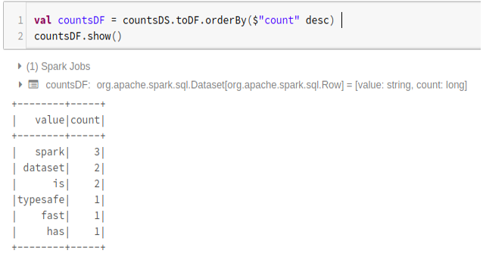
2. Convert Spark Dataset to Dataframe
We can also convert Spark Dataset to Datafame and utilize Dataframe APIs as below:

Slide 15
Features of Spark DataSet
Below are the different features of Spark Dataset:
1. Type Safety: Dataset provides compile-time type safety. It means that the application’s syntax and analysis errors will be checked at compile time before it runs.
2. Immutability: Dataset is also immutable like RDD and Dataframe. It means we can not change the created Dataset. Every time a new dataset is created when any transformation is applied to the dataset.

Slide 16
3. Schema: Dataset is an in-memory tabular structure that has rows and named columns.
4. Performance and Optimization: Like Dataframe, the Dataset also uses Catalyst Optimization to generate an optimized logical and physical query plan.
5. Programming language: The dataset api is only present in Java and Scala, which are compiled languages but not in Python, which is an interpreted language.
6. Lazy Evaluation: Like RDD and Dataframe, the Dataset also performs the lazy evaluation. It means the computation happens only when action is performed. Spark makes only plans during the transformation phase.

Slide 17
7. Serialization and Garbage Collection: The spark dataset does not use standard serializers(Kryo or Java serialization). Instead, it uses Tungsten’s fast in-memory encoders, which understand the internal structure of the data and can efficiently transform objects into internal binary storage. It uses off-heap data serialization using a Tungsten encoder, and hence there is no need for garbage collection.

Slide 18
Working with RDDs
An RDD, which stands for Resilient Distributed Dataset, is one of the most important concepts in Spark.
It is a read-only collection of records which is partitioned and distributed across the nodes in a cluster.
It can be transformed into some other RDD through operations, and once an RDD is created, it cannot be changed; rather, a new RDD will be created.

Slide 19
One important feature through which Spark overcame the limitations of Hadoop is via RDD because rather than replicating the data, Resilient Distributed Datasets (RDD) maintains the data across the nodes in a cluster and will recover back the data with the help of a lineage graph.
In Hadoop, the data was redundantly stored among the machines, which provided the property of fault tolerance.
Thus an RDD is a fundamental abstraction provided by Spark for distributed data and computation.

Slide 20
The different ways of creating an RDD are
Loading an external data set
Passing the data through Parallelize method
By transforming an existing RDD

Slide 21
Ways to create RDD in Spark
Below are the different ways to create RDD in Spark:
1. Loading an external data set
SparkContext’s textFile method is used for loading up the data from any source, which in turn creates an RDD.
Spark supports a wide range of sources from which the data can be pulled, such as Hadoop, HBase, Amazon S3, etc.
One data source is a text file that we have discussed here. Apart from text files, spark’s scala API also supports other data formats such as wholeTextFiles, sequence file, Hadoop RDF and many more.

Slide 22
Example
The variable called file is an RDD, created from a text file on the local system.
In spark-shell, spark context object (sc) has already been created and is used to access spark.
TextFile is a method of an org.apache.spark.SparkContext class that reads a text file from HDFS, a local file system or any Hadoop-supported file system URI and return it as an RDD of Strings.
Thus the input for this method is a URI and partitions the data across the nodes.

Slide 23
2. Passing the data through Parallelize method
Another way of creating RDDs is by taking an existing in-memory collection and passing it to parallelize the method of SparkContext.
While learning spark, this way of creating RDDs is quite useful as we can create the RDDs in the shell and perform operations as well.
It is hardly used outside testing and prototyping as it requires the entire data to be available on the local machine.

Slide 24

One important point about parallelizing is the number of partitions the collection is broken into.
We can pass the number (partitions) as a second parameter in the parallelize method, and if the number is not specified, Spark will decide based on the cluster.
Without a number of partitions:

Slide 25

With a number of partitions:
3. By transforming an existing RDD
There are two kinds of operations that are performed over RDD.
Transformations
Actions

Slide 26
Transformations are operations on RDD that result in the creation of another RDD, whereas actions are the operations that return a final value to the driver program or write data to an external storage system. Map and filter are some transformation operations.
Consider an example of filtering out some lines from a text file. Initially, an RDD is created by loading the text file. Then we apply a filter function that will filter out a set of lines from the text file.
The result will also be an RDD. The filter operation does not change the existing input RDD. Instead, it returns a pointer to an entirely new RDD which is the errors red.

Slide 27


The below example shows the same transformation concept for a map function.
The result is the RDD that has been generated due to the Map function. In the map operation, the logic will be defined, and that particular logic will be applied to all the elements of the dataset.

Slide 28
Using DataFrame Aggregate Functions
Spark SQL provides built-in standard Aggregate functions defines in DataFrame API, these come in handy when we need to make aggregate operations on DataFrame columns.
Aggregate functions operate on a group of rows and calculate a single return value for every group.
All these aggregate functions accept input as, Column type or column name in a string and several other arguments based on the function and return Column type.

Slide 29
When possible try to leverage standard library as they are little bit more compile-time safety, handles null and perform better when compared to UDF’s.
If your application is critical on performance try to avoid using custom UDF at all costs as these are not guarantee on performance.

Slide 30
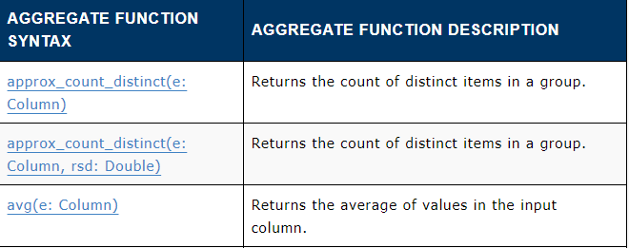
Spark Aggregate Functions
Spark SQL Aggregate functions are grouped as “agg_funcs” in spark SQL.
Below is a list of functions defined under this group.

Slide 31
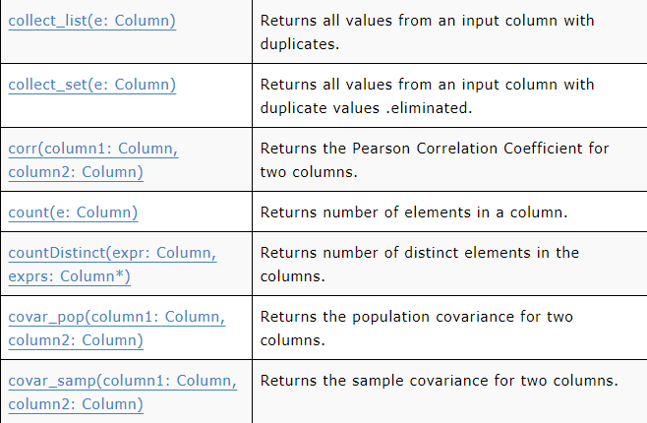

Slide 32
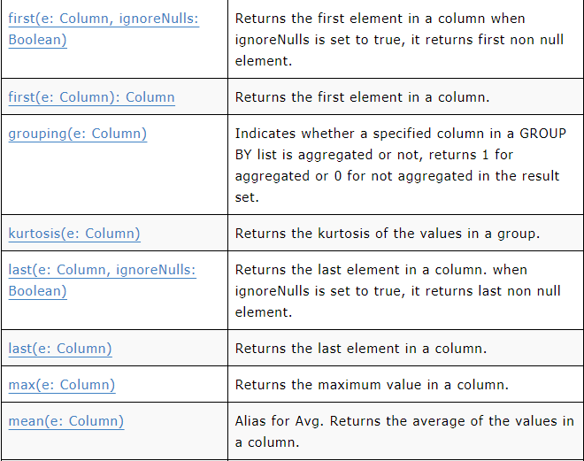

Slide 33
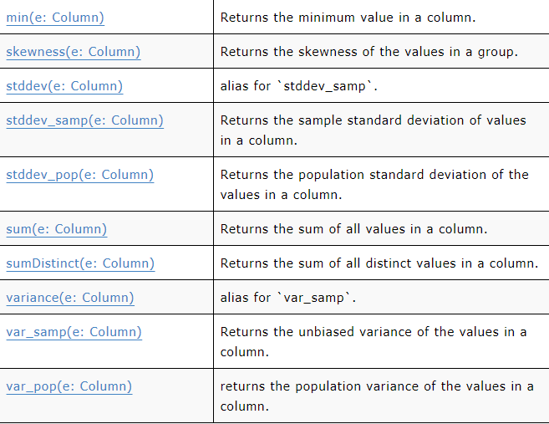

Slide 34
approx_count_distinct Aggregate Function
approx_count_distinct() function returns the count of distinct items in a group.
avg (average) Aggregate Function
avg() function returns the average of values in the input column.
collect_list Aggregate Function
collect_list() function returns all values from an input column with duplicates.
collect_set Aggregate Function
collect_set() function returns all values from an input column with duplicate values eliminated.

Slide 35
countDistinct Aggregate Function
countDistinct() function returns the number of distinct elements in a columns
count function()
count() function returns number of elements in a column.
grouping function()
grouping() Indicates whether a given input column is aggregated or not. returns 1 for aggregated or 0 for not aggregated in the result.

Slide 36
first function()
first() function returns the first element in a column when ignoreNulls is set to true, it returns the first non-null element.
last()
last() function returns the last element in a column. when ignoreNulls is set to true, it returns the last non-null element.
kurtosis()
kurtosis() function returns the kurtosis of the values in a group.

Slide 37
max()
max() function returns the maximum value in a column.
min()
min() function returns the minimum value in a column.
mean()
mean() function returns the average of the values in a column. Alias for Avg
skewness()
skewness() function returns the skewness of the values in a group.

Slide 38
stddev(), stddev_samp() and stddev_pop()
stddev() alias for stddev_samp.
stddev_samp() function returns the sample standard deviation of values in a column.
stddev_pop() function returns the population standard deviation of the values in a column.
sum()
sum() function Returns the sum of all values in a column.

Slide 39
sumDistinct()
sumDistinct() function returns the sum of all distinct values in a column.
variance(), var_samp(), var_pop()
variance() alias for var_samp
var_samp() function returns the unbiased variance of the values in a column.
var_pop() function returns the population variance of the values in a column.

Slide 40
END OF SESSION
Q&A

